Slide 1
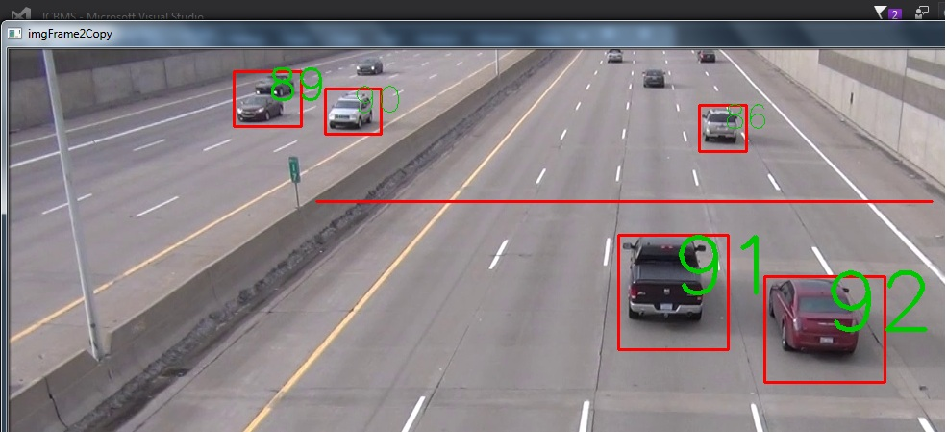
SELF DRIVING CARs PART II
This Photo by Unknown Author is licensed under CC BY-SA

Slide 2
SIMPLE LANE DETECTION

Slide 3
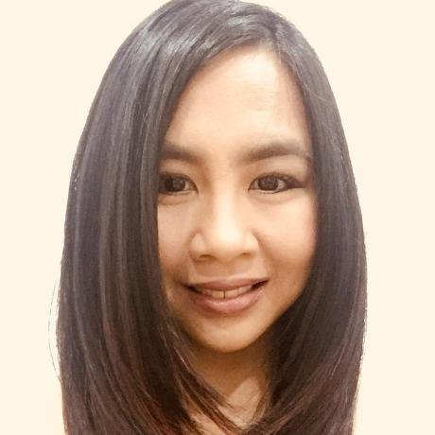
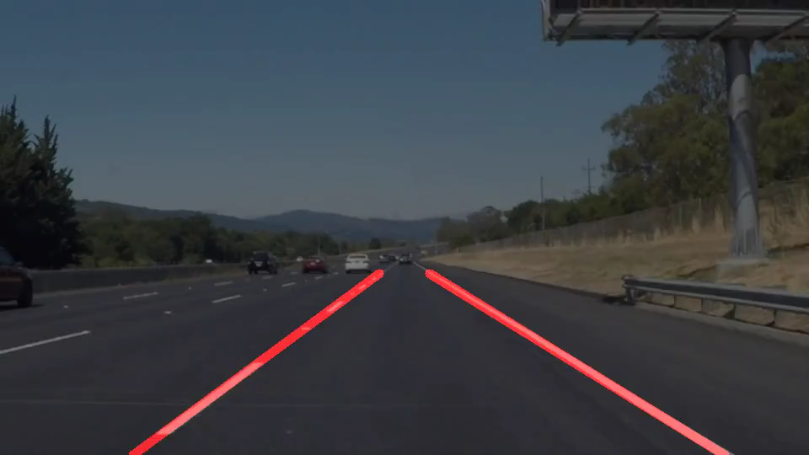
Acknowledgment:
The code for basic lane detection is from Mithi Sevilla. We used this as the foundation to write our tests. The repository can be found at:
https://github.com/mithi/basic-lane-detection
Robo-Geek is always grateful to the open source community. Our project is also being shared in reprocity.

Slide 4
The pipeline
The pipeline consists of 6 steps:
1. Preprocess the initial image
2. Get the edges from preprocessed image
3. Block out everything except the region of interest
4. Get the lines from the edges
5. Draw the lines or extrapolate the lines
6. Overlap/overlay the drawn/extrapolated lines to the initial image
Step 1
Step 2
Step 3
Step 4
Step 5
Step 6

Slide 5
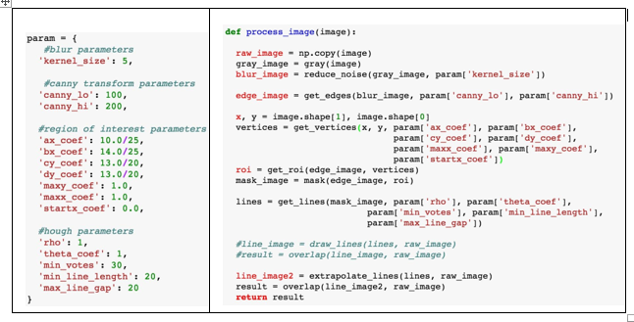
The CODE
Parameters
6 Steps used in the Pipeline

Slide 6
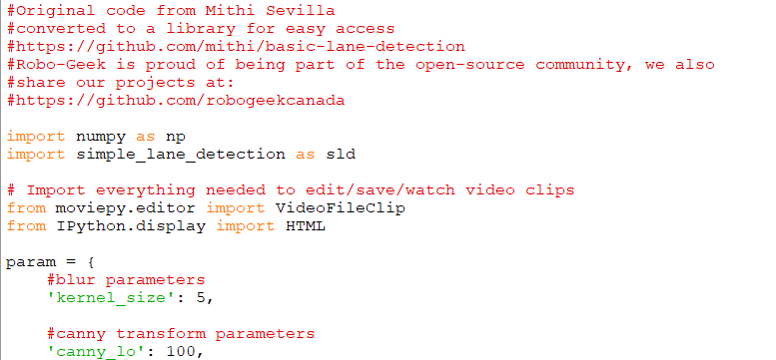
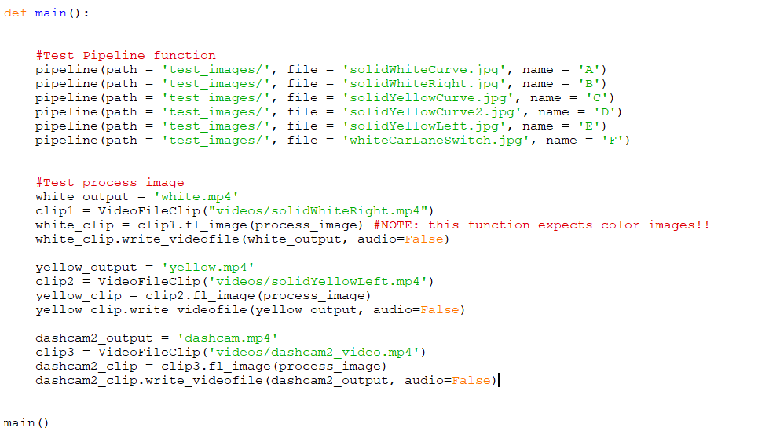
First we created a library called simple_lane_detection.
Second, using the library we connected to the pipeline to test the process for image conversion and finally we used this for video processing.

Slide 7
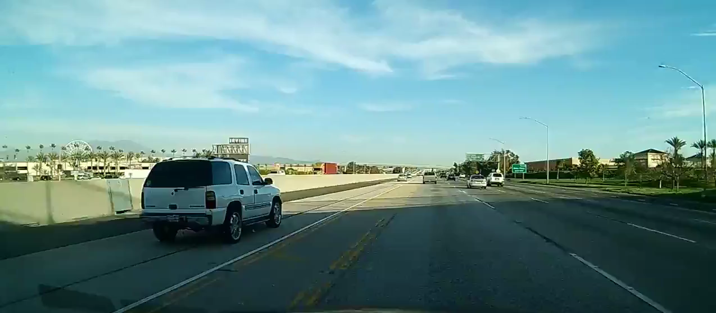
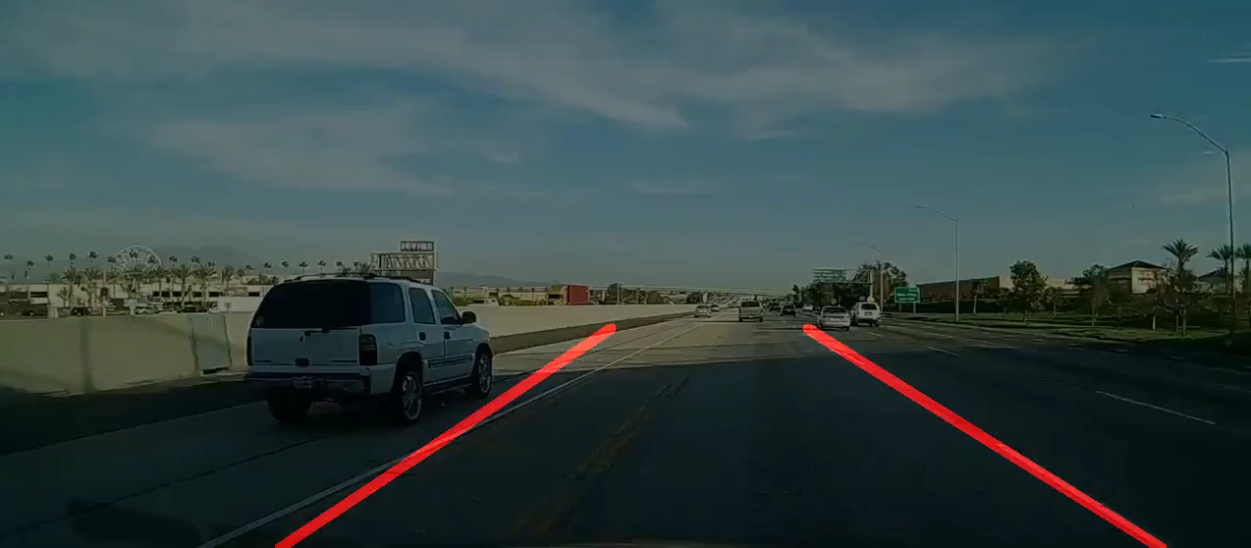
Testing

